Slide 1
“What is horrible is basically funny. In fiction.”

Slide 2
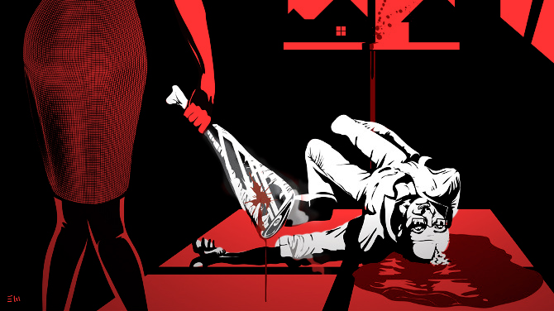
LAMB TO THE SLAUGHTER
Sunday, December 11, 2016

Slide 3
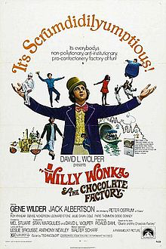
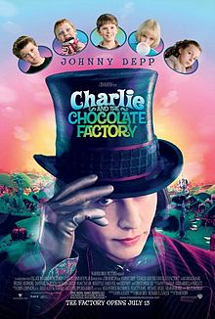
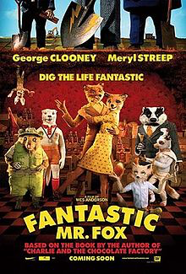
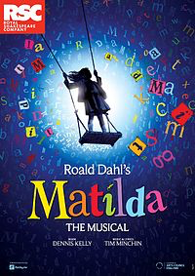
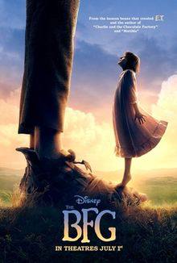

Slide 4
Roald Dahl
1916 – Born in South Wales
1920 – Dahl’s father passes away
1939 – Joins the Royal Air Force
1942 – Dahl writes his first children story, The Gremlins.
1950’s – Publishes collections of short stories
1961 – Writes James and the Giant Peach, and becomes known for his children literature
1990 – Dahl passes away due to an unknown infection
Overall, Dahl wrote 19 children’s books and nine short story collections

Slide 5
"Children are ... highly critical. And they lose interest so quickly. You have to keep things ticking along. And if you think a child is getting bored, you must think up something that jolts it back. Something that tickles. You have to know what children like."

Slide 6
Lamb to the Slaughter
How does the title refer to the story? Who is the victim?
When in the story did you realize that this was a murder story? Why?
Do you sympathize with the murderer in this story? Why or why not?
How does the way the story is narrated influence your opinion?
What is Patrick Maloney referring to when he says "I know it’s kind of a bad time to be telling you?"
Why are we not told exactly what he said to Mary? What do you think he said?
Why does the sentence “A leg of lamb." appear on a separate line?
Which words indicate that Mary does not think before she strikes her husband?
What are Mary Maloney´s reasons for covering up the crime?
Do you think Mary will get away with the crime? Do you think she should?

Slide 7
Question 1 – Information Retrieval
Worth 4 marks – spend 5 minutes answering it.
AO1
Identify and interpret explicit and implicit information and ideas.
Select and synthesise evidence from different texts.
Look at the source.
Look at lines …... What four things do we learn about…
Use quotations to support each point.

Slide 8
QUESTION 1 PRACTICE
Look at lines 1-8.
What do you learn about Mary Maloney? List four points.
Highlight parts of the section that could be used to answer this question.
Notes:
Correct statements: a, b, d, f

Slide 9
WHAT DO YOU LEARN ABOUT MARY MALONEY?
The room was warm, the curtains were closed, the two table lamps were lit. On the cupboard behind her there were two glasses and some drinks. Mary Maloney was waiting for her husband to come home from work.
Now and again she glanced at the clock, but without anxiety: She merely wanted to satisfy herself that each minute that went by made it nearer the time when he would come home. As she bent over her sewing, she was curiously peaceful. This was her sixth month expecting a child. Her mouth and her eyes, with their new calm look, seemed larger and darker than before.
When the clock said ten minutes to five, she began to listen, and a few moments later, punctually as always, she heard the car tires on the stones outside, the car door closing, footsteps passing the window, the key turning in the lock. She stood up and went forward to kiss him as he entered.

Slide 10
WHAT DO YOU LEARN ABOUT MARY MALONEY?
The room was warm, the curtains were closed, the two table lamps were lit. On the cupboard behind her there were two glasses and some drinks. Mary Maloney was waiting for her husband to come home from work.
Now and again she glanced at the clock, but without anxiety: She merely wanted to satisfy herself that each minute that went by made it nearer the time when he would come home. As she bent over her sewing, she was curiously peaceful. This was her sixth month expecting a child. Her mouth and her eyes, with their new calm look, seemed larger and darker than before.
When the clock said ten minutes to five, she began to listen, and a few moments later, punctually as always, she heard the car tires on the stones outside, the car door closing, footsteps passing the window, the key turning in the lock. She stood up and went forward to kiss him as he entered.

Slide 11
QUESTION 1 PRACTICE
How does Mary feel after killing her husband? List four points.
Highlight parts of the section that could be used to answer this question.
Notes:
Correct statements: a, b, d, f

Slide 12
She stepped back, waiting, and the strange thing was that he remained standing there for at least four or five seconds. Then he crashed onto the carpet.
The violence of the crash, the noise, the small table overturning, helped to bring her out of the shock. She came out slowly, feeling cold and surprised, and she stood for a few minutes, looking at the body, still holding the piece of meat tightly with both hands.
All right, she told herself. So I've killed him.
It was extraordinary, now, how clear her mind became all of a sudden. She began thinking very fast. As the wife of a detective, she knew what the punishment would be. It made no difference to her. In fact, it would be a relief. On the other hand, what about the baby? What were the laws about murderers with unborn children? Did they kill them both -- mother and child? Did they wait until the baby was born? What did they do? Mary Maloney didn't know and she wasn't prepared to take a chance.
She carried the meat into the kitchen, put it into a pan, turned on the oven, and put the pan inside. Then she washed her hands, ran upstairs, sat down in front of the mirror, fixed her makeup, and tried to smile.

Slide 13
QUESTION 1 ANSWERS
For question 1 there are two options:
Identify and retrieve the quotation which answers the question.
Synthesise the quotation by explaining what it means.
Task:
Explain the following quotations:
‘she began thinking very fast’
‘Mary Maloney didn't know and she wasn't prepared to take a chance’
Sometimes a quotation will be enough but at other times a brief explanation may be needed.
Notes:
Mary is anxious and worried about what to do next.
Mary knows she needs to take action to protect herself.

Slide 14
The Woman in White – HW
Question 1
Look at lines 1-8.
What four things from this section of text that tell us about Lady Glyde’s state?
Highlight the extract and write your answers.
15 minutes

